Slide 1
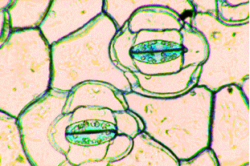
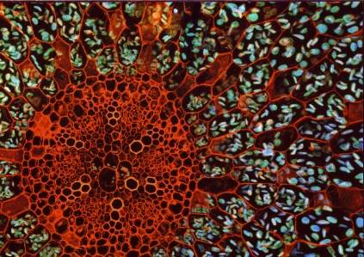
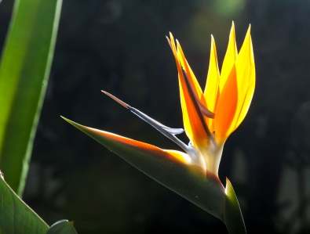
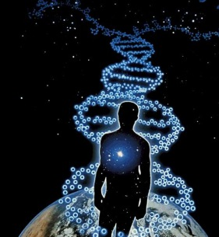
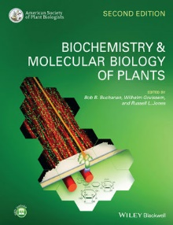
Study Circle for Ph. D. Students
Thursday, 16:00, Seminar Room 506-507. Book of the year:
20.09.2019 kick-off and plan
26.09.2019 Sarheed – Natural Products (Chapter 23-1)
03.10.2019 Holiday (German Unity Day)
10.10.2019 Nasim – Natural Products (Chapter 23-2
17.10.2019 Islam – Long Distance Transport (Chapter 15)
24.10.2019 Islam – Long Distance Transport (Chapter 15)
31.10.2019 Christian – Carbohydrate Metabolism (Chapter 13)
07.11.2019 Christian – Carbohydrate Metabolism (Chapter 13)
14.11.2019 Revision of Unit 1: Compartments
21.11.2019 Kunxi – Respiration, Photorespiration (Chapter 14)
28.11.2019 Kunxi – Respiration, Photorespiration (Chapter 14)
05.12.2019 Karwan - Hormone Biosynthesis (Chapter 17)
12.12.2019 Karwan - Hormone Biosynthesis (Chapter 17)
19.12.2019 General topic: Genetics
Chapters 12 (Photosynthesis, Pallavi), 18 (Signal Transduction, Daniela), 19 (Reproductive Development, Ali) have already been presented

